Slide 1


The Recruiter Accelerator Club
Session 1 – Getting the basics right to increase confidence

Slide 2
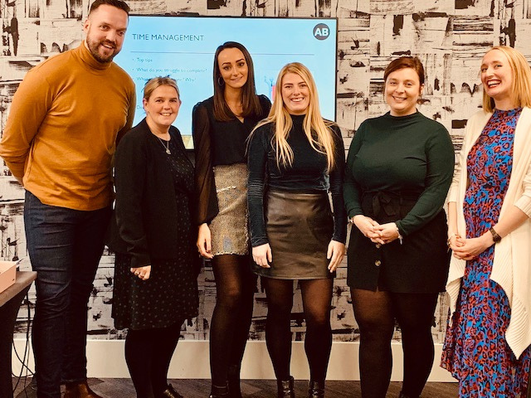
Welcome!
How will the RAC work?
How will Ali support me?
Objectives for todays session
sub text sub text sub text sub text sub tex sub text

Slide 3
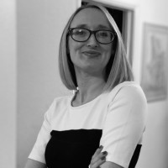
17 years industry experience
Welcome!
Consultant
Senior consultant
L and D consultant
Internal recruitment manager
Associate Director
Director of Operations
Consultancy owner
All about me…
But this group is all about you!
How about you?

Slide 4

How will the RAC work?
Week 1 – Webinar
Week 2 –
Week 3 – Drop in clinic
Week 4 -
How will Ali support me?

Slide 5
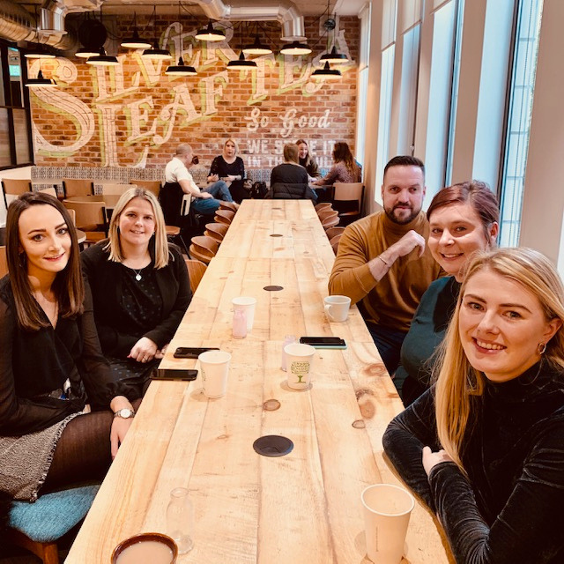
Objectives for the session:
Why do 95% of recruiters fail?
What’s changed – the job or you?
Where are you going?
Breaking new habits and forming new ones
The importance of having a plan
Where is your regular pipeline?

Slide 6
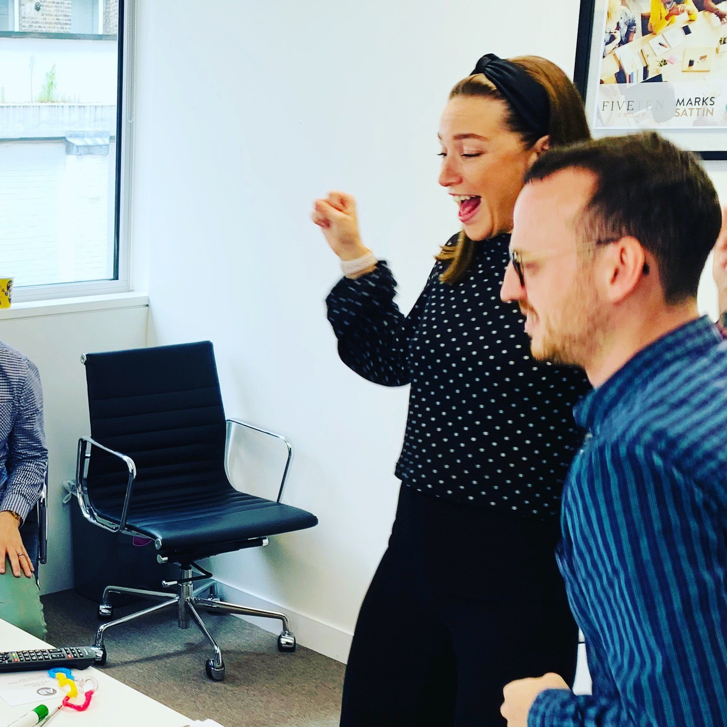
Why do 95% recruiters fail in sales?
Failure to build a specific market niche
Failure to identify multiple points of contact
Failure to set multiple objectives for calls
Failure to Listen – Be Interested, not Interesting
Failure to follow the KLT’s
Failure to follow up

Slide 9
What’s changed? The Job? Or is it you?
Header text
Header text
Header text
sub text sub text sub text sub text sub text sub text sub text sub text sub text sub text sub text sub text sub text sub text sub text sub text sub text sub text sub text sub text sub text sub text sub text sub textsub text sub text sub text sub text sub text sub text sub text sub text sub text sub text sub text sub text
sub text sub text sub text sub text sub text sub text sub text sub text sub text sub text sub text sub text sub text sub text sub text sub text sub text sub text sub text sub text sub text sub text sub text sub textsub text sub text sub text sub text sub text sub text sub text sub text sub text sub text sub text sub text
sub text sub text sub text sub text sub text sub text sub text sub text sub text sub text sub text sub text sub text sub text sub text sub text sub text sub text sub text sub text sub text sub text sub text sub textsub text sub text sub text sub text sub text sub text sub text sub text sub text sub text sub text sub text

Slide 10





Where are you going?
Text text text text text
sub text sub text sub text
sub text sub text sub text
sub text sub text sub text
sub text sub text sub text
sub text sub text sub text
sub text sub text sub text
sub text sub text sub text
sub text sub text sub text
sub text sub text sub text
sub text sub text sub text
sub text sub text sub text
sub text sub text sub text

Slide 11
17 years industry experience
Have a plan!
Consultant
Senior consultant
L and D consultant
Internal recruitment manager
Associate Directo
Director of Operations
Consultancy owner
All about me…
But this group is all about you!
How about you?

Slide 12

Why should I have a plan…

Slide 13
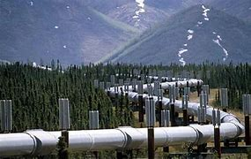
Why have a pipeline?

