Slide 1
Module 7
Negotiations for the Win/Win!

Slide 2
How do the webinars work?
1.5 hours of training content
Every month we will cover a different topic
We will have one comfort break of 5 minutes!
We will use the chat room, Miro boards and live discussion. There will be group work when appropriate and the numbers allow – so get involved!
We do need to see each others faces! Unless I explain otherwise e.g. if we have a lot of content to get through and we are running out of time
I will always ask you for questions
I will always ask for your full attention
You will always have mine
We will respect the confidentiality of our clients, candidates and colleagues

Slide 3
Objectives for this session:
Understand there is always an opportunity for negotiation
Use different negotiation techniques and know the structure for best results
Be able to make business decisions based on the needs of the business and individual
Be able to tie it back to planning – goals / why you are here

Slide 4
By the end of this session you will be able to: Enter into negotiations confidently and with a plan! Use different techniques with both clients and candidates feel confident in and able to apply techniques when negotiating terms

Slide 5
Candidate contact
Business development with client
Instructed by the client- get job spec
search/headhunt
set up interviews
Get an offer/liaise between client and cand
Feedback
What can we negotiate?
TheRecruitmentTrainer.co.uk

Slide 6
WHAT ARE THE COMMON MISTAKES?
Setting fees too low
Offering a discount without being asked
Not dealing with the decision maker
Not meeting a client face to face
Discussing price too early before you have established creditability and need
Not being confident enough
Using language which implies you are willing to negotiate
Apologising for your price
Backing down too easily – not knowing when to say ‘No’
Failing to help your clients perceive the value you provide
TheRecruitmentTrainer.co.uk

Slide 7
WHAT IS AVAILABLE TO US & THE CLIENT
What can we offer?
What can the client offer?
Discuss in your groups - 5 minutes

Slide 8
THERE IS ALWAYS AN OPPORTUNITY TO NEGOTIATE
What can we negotiate?
Budgets
Pay
Start date
End date
Interview day and times

Slide 9
LEWICKI & HAIM NEGOTIATI0N MATRIX

Slide 10
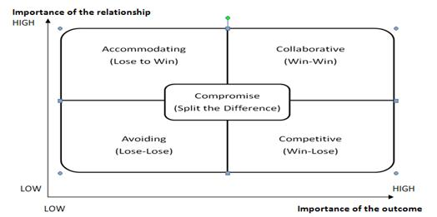

Slide 11
NEGOTIATION SKILLS
Outcome Important – Relationship Important
Outcome Important – Relationship Unimportant
Outcome Unimportant – Relationship Important
Outcome Unimportant – Relationship Unimportant

Slide 12
THE WIN-WIN APPROACH

Slide 13
PROBLEM IDENTIFICATION
You need to identify all parties’ interests and needs and uncover the concerns that the other party may have.
e.g. What need is driving them?
What do they fear?
What motivates the negotiator to take their current position?

Slide 14
PROBLEM STATEMENT TIPS
Acceptable
Make it mutually acceptable
Neutral
Make it neutral
Goal
State the problem as a goal
Don’t jump
Don’t jump to solutions
TheRecruitmentTrainer.co.uk

Slide 15
Expand the Pie Add more resources – for example can they increase the budget by waiting until next budget review? Or can they get funding from another part of the business?
SOLUTION GENERATION

Slide 16
Compromise/ Log rolling
This works if each side has different preferences so no one is losing out. For example, you might ask for interviews to be held earlier to speed up the process, the client may want one more stage in the interview process but you agree as the whole process will still take less than a fortnight.

Slide 17
Non- Specific Compensation
This is a form of payoff – do you know what the other party values? You need to make sure this is still a win win for both sides. For example – you are happy to offer a reduction in rate, from 25% to 22%, (perhaps you were happy with 20%!)

Slide 18
Cost Cutting
This allows one party to achieve its objectives whilst the other minimises its costs.
For example – the client works with you on a retained basis with a shorter rebate period – if budget is a real issue for them. This is the opposite of non-specific compensation - you are relieving a burden or suffering so you need a good understanding of their interests.

Slide 19
Bridging
This is when you come up with completely news options that meet the needs of both sides.
e.g. the client may have asked for 20% you asked for 22%
As a bridge – you may suggest starting with 22%, but going down by 1% for each new role down to 18% for multiple roles in the future.

Slide 20
WHAT IS YOUR NEGOTIATION SITUATION?
Discuss together – what is your negotiation situation? Can you think of examples of how you would expand the pie/ log roll/ bridge?

Slide 21
SHOW YOUR POSITION BY:
Acknowledge the other parties interested
Indicate a willingness to change your proposals
Demonstrate the desire to solve the problems
Maintain open communications
Reaffirm what is critically important
Re-examine any areas where you suspect you may not be considering the other party’s needs.

Slide 22
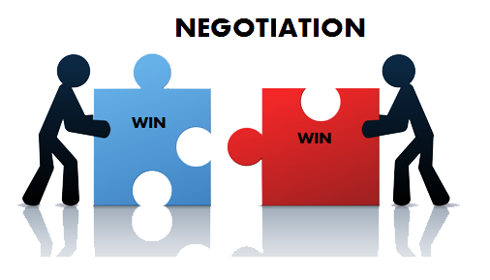
NEGOTIATION OF FEES
Of course a big part of negotiation in recruitment is for fees.
Work to budget
Margin not mark up. Ensure that we are always working to margin – it sounds less to client, but it’s more for us!
Example: Candidate Pay pd £400 Client total charge pd £500, profit is £100,
Margin up on this is 25%. Mark up on this is 20%

Slide 23
Only move in small increments, why do we always move in 5%? How about 0.5% !?
Work in £ not %, deduct £ of final invoice value rather than % as sounds more!
Example: Fee is £20,000 deduct £2000, sounds better than 10%
Work on a sliding scale
Example:
First job at 30%
Second job at 25%
Third job a at 20%
Fourth job at 20%

Slide 24
Like – This is your top line, i.e the outcome you’d ‘like’ to achieve.
e.g Fees paid at full Terms of business rates
Intend – This is a realistic outcome you actually ‘intend’ to achieve in a kind of ‘aim for the stars and reach for the moon’ type scenario.
e.g £500 of final invoice and exclusivity
Must – This is your actual bottom line that you can not go beyond. It may be due to it being non profitable to go beyond this, or it may be outside of your personal authority limits.
e.g £500 of final invoice and 1 week exclusivity
LIM
TheRecruitmentTrainer.co.uk

Slide 25
PSL
Primary
25% on this, exclusivity and future placements
Secondary
22% on this placement and 1 week exclusivity
Last resort
20% on this placement and a meeting to discuss future placements

Slide 26
WHAT IS YOUR PREFERRED METHOD OF NEGOTIATION?
What will work for you? Share with the group!

Slide 27
The Next drop in Q & A will be on Wednesday 17th - 12- 1p.m.
If you would like a 20 minute call to discuss your actions and get help implementing them - please reply to my email!
We will talk through your wins, what you can use from this masterclass going forward and start to think about your Q1 plan.
Your actions are to think about –
What will you try and use after this session?
What is your 1 commitment? Write it on your action plan
Module 6 Action plan will be added to the members area, with the recording of this session

