Slide 1


Module 5
Control and Building effective relationships

Slide 2

How do the webinars work?
1.5 hours of training content
Every month we will cover a different topic
We will have one comfort break of 5 minutes!
We will use the chat room, Miro boards and live discussion. There will be group work when appropriate and the numbers allow – so get involved!
We do need to see each others faces! Unless I explain otherwise e.g. if we have a lot of content to get through and we are running out of time
I will always ask you for questions
I will always ask for your full attention
You will always have mine
We will respect the confidentiality of our clients, candidates and colleagues

Slide 3

Objectives for this session:
To understand -
What is Control?
Why do we need it?
Where can we lose it?
Control techniques for both clients and candidates
Account management – what are the key questions we should be asking?
How this relates to our candidates

Slide 4
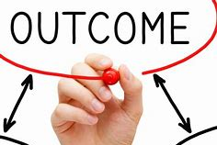
By the end of this session you will be able to:
Identify relationships that need additional work
Have a plan of action for one client and one candidate to start working on immediately
Identify key control situations in your processes and know how to rectify them

Slide 5

What does this mean?
Why do we want it?
How can we achieve it?

Slide 6
The formula for Control:
Information
= Knowledge
= Power
= Control
= ££££

Slide 7

Information
The questions we are ask our clients and candidates are key…

Slide 8
The more information we have, and the better we know and understand our clients and candidates – pains, goals and everyday needs - gives us more control

Slide 9
This requires EFFORT and TIME from us

Slide 10

“Are you listening to reply or listening to understand?”
Steven R Covey, The 7 Habits of Highly effective people

Slide 11

What else does control allow us?
To build better relationships
To have a greater understanding of what our clients and candidates need
We can sell more effectively
More buy in
Healthier, more honest and ethical partnerships

Slide 12

Candidate contact
Business development with client
Instructed by the client- get job spec
search/headhunt
set up interviews
Get an offer/liaise between client and cand
Feedback
Where can we lose control
in the job cycle?
And what is the affect?

Slide 13


Why do we think these issues happen to us?

Slide 14
Usually – it is because we have forgotten the formula!
Most people do not set out to annoy us!
They all have their reasons for behaving in the way they do
How can we ensure we get maximum buy in and control?
What have we not done, or not done well enough?

Slide 15
Top tips for gaining and keeping control
Ask the difficult questions
Don’t ignore red flags
Use your intuition – it’s always right
Control starts at the beginning of the relationship with your client and candidate
Where abouts is this on the job cycle?

Slide 16

Account Management
Account Management is quite simply identifying those clients that are going to give you the biggest return in investment, and then cultivating your relationship with that client
This is also true for your candidates
It’s about developing the relationship with your existing clients, so that you are always at the forefront of their mind when they are looking to recruit
Analysis across the recruitment sector has shown us that the top biller’s gain the majority of their revenue (between 50 and 95%) from only 5 clients… Could you name yours now?

Slide 17

Exercise – Agency 1 v Agency 2
Imagine that you are a client, currently recruiting for 2 vacancies using 2 agencies
Agency 1 has visited you to take the job brief, even though they have recruited for you before
Agency 2 takes the job brief over the phone
Agency 1 phones you to say that they have identified 2 potential candidates, and talks you through their profiles and key achievements
Agency 2 emails across 2 CV’s.
Agency 1 phones you every day with an update on progress and to give you feedback from the candidates
Agency 2 only phones you when they have found more candidates.
At this stage, if you were the client, who would be your agency of choice?
Notes:
Trainer notes
Talk through with delegates what it is that agency 1 is doing that makes you want to work with them, and what the benefits will be

Slide 18

The 7P Wheel
A tool devised to take the guess work out of Account Management
There are 7 key areas in each account that if you invest the time in getting to understand, will help you to manage the account better
Promoter Champion
Probe for pain
Prove Value
People
Power
Politics
Process

Slide 19
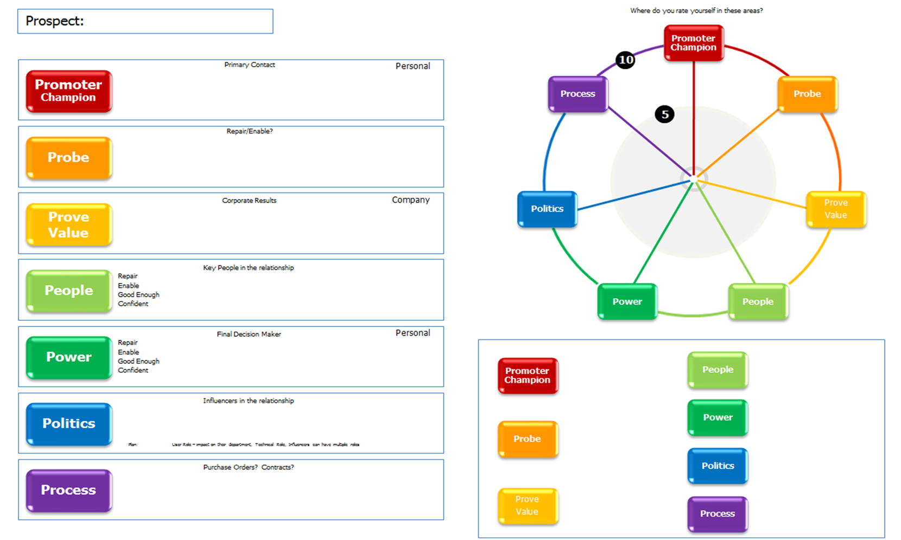
The 7P wheel of account management
Notes:
Trainer notes:
The 7P wheel is a simple tool that delegates can use to map out each individual client and where they need to delve deeper to identify the potential within the account.
Its essentially a planning tool and one can be completed for each client
The circle on the right is a visual representation of the account. You can out a cross on the line for each P based on where you currently are on a scale of 1-10
The boxes on the left is where you write the action you’re going to take to increase the score on each “P”
The box on the bottom right is just to write the actual number you gave each “P”

Slide 20
Promoter
The Promoter is the person who is your main point of contact
How good is your relationship with them?
Could it be better?
What are your Promoters personal targets?
If they have targets for recruitment, how can you help them achieve them?
Can they help you with any of the other “P’s”?

Slide 21


Probe
Have you questioned the client sufficiently to know what their future recruitment plans are?
Do you know what their “pain” is? Their pain is the reason why they need to work with you and not do the recruitment themselves
Do you know all you need to know about their business?
Ask probing questions to understand the client and their business

Slide 22
Prove value
How does the client measure success in their company?
Is it just revenue or are there other measures?
How can you help the client in a way that directly links to how they measure success?
Example – if one of the company’s targets is to lower attrition, can you add value to that by helping them find people that are the right for the business?
How can you personally add value to the client’s business?

Slide 23

People
Do you know who all the key people are in the business?
Do you only have the one contact? What would happen if they left?
Who else might you need to make contact with?
Knowing who all the relevant decision makers are increases your effectiveness within an account
How are you going to make contact with them?
Can you use your Promoter to help you?

Slide 24
Power
Who has the main power within the account?
Who is/are the decision makers?
Do you know what’s important to them?
You may not be able to/need to get in front of the key decision maker but it helps to know who they are and what obstacles they may cause

Slide 25
Politics
Are they dealing with any other recruiters?
If so, do you know how much of the clients business the other recruiters have?
Are there any internal politics going on that might cause any problems?
Sometimes there are multiple decision makers, all with different agenda’s
By understanding the politics, you are better able to navigate the account and avoid treading on anyone’s toes

Slide 26
Process
What is their recruitment process?
From when a client says “yes, go ahead and recruit for me” to you getting paid by the client, how long does that usually take?
What is the actual process? Purchase orders, contract, preferred supplier list?
Who needs to sign what?
Don’t let a lack of understanding of their internal processes be the one thing that holds up the recruitment process
If you don’t know, ask!

Slide 27

Think about a key client you have identified you want to work with
Complete a 7P wheel on an existing client
Example, if you are a 3 with your Promoter, what action do you need to take to increase it to a 5?
Look for small wins rather than huge leaps in score – remember it takes time to build a relationship
Mark yourself honestly and for each P, write an action that you are going to take that will increase the score for each P
Notes:
Trainer notes
Brief the delegates playing the client as follows:
They have two other agencies that they’ve spoken to who are cheaper but you’ve worked with them both previously and they weren’t able to deliver on the timeframes or quality of candidates
You’re willing to risk giving all three roles to this recruiter but you need some guarantees before you agree to their fees and would like a discount on 20% as they’re getting all three roles. You’re also willing to offer any future roles but only if this hire goes well.
Listen and observe each group offering feedback if necessary
Their key objective is to ask sufficient questions to understand what terms can be negotiated and to then present a viable solution for both parties.

Slide 28

Now think of a candidate you have a great relationship with
How did you get there?
What did you do to build that relationship over time?
WHY is closing the call well so important?

Slide 29
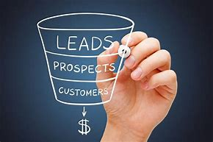
Now think about a candidate that you want to build a better relationships with
What can you repeat with this candidate?
Notes:
This is on the members area

Slide 30
Does the P Wheel work for candidates?
Complete a 7P wheel on a candidate you want to work with
Example, if you are a 3 with your People , what action do you need to take to increase it to a 5?
Which P’s don’t apply? Why? Which do? Why?
Mark yourself honestly and for each P, write an action that you are going to take that will increase the score for each P
Notes:
Trainer notes
Brief the delegates playing the client as follows:
They have two other agencies that they’ve spoken to who are cheaper but you’ve worked with them both previously and they weren’t able to deliver on the timeframes or quality of candidates
You’re willing to risk giving all three roles to this recruiter but you need some guarantees before you agree to their fees and would like a discount on 20% as they’re getting all three roles. You’re also willing to offer any future roles but only if this hire goes well.
Listen and observe each group offering feedback if necessary
Their key objective is to ask sufficient questions to understand what terms can be negotiated and to then present a viable solution for both parties.

Slide 31

Feedback and evaluation
What have been your key learning points from this session?
What do you need to work on?

Slide 32
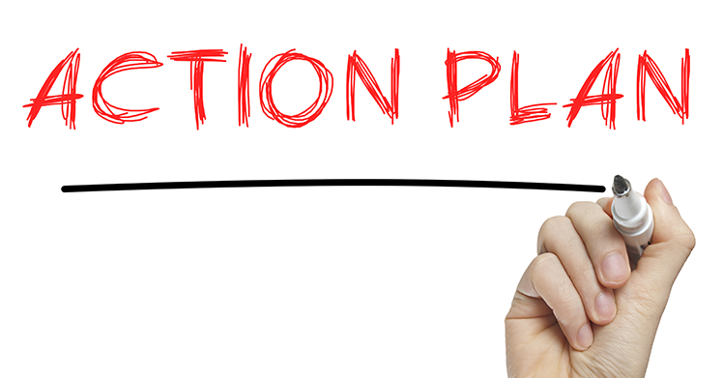

The Next drop in Q & A will be on Wednesday 27th – time tbc
If you would like a 20 minute call to discuss your actions and get help implementing them - please reply to my email!
We will talk through your wins, what you can use from this masterclass going forward and start to think about your Q1 plan.
Your actions are to think about –
What will you try and use after this session?
What is your 1 commitment? Write it on your action plan
Module 5 Action plan will be added to the members area, with the recording of this session

