Slide 1
Module 4
Overcoming objections with Flair!

Slide 2
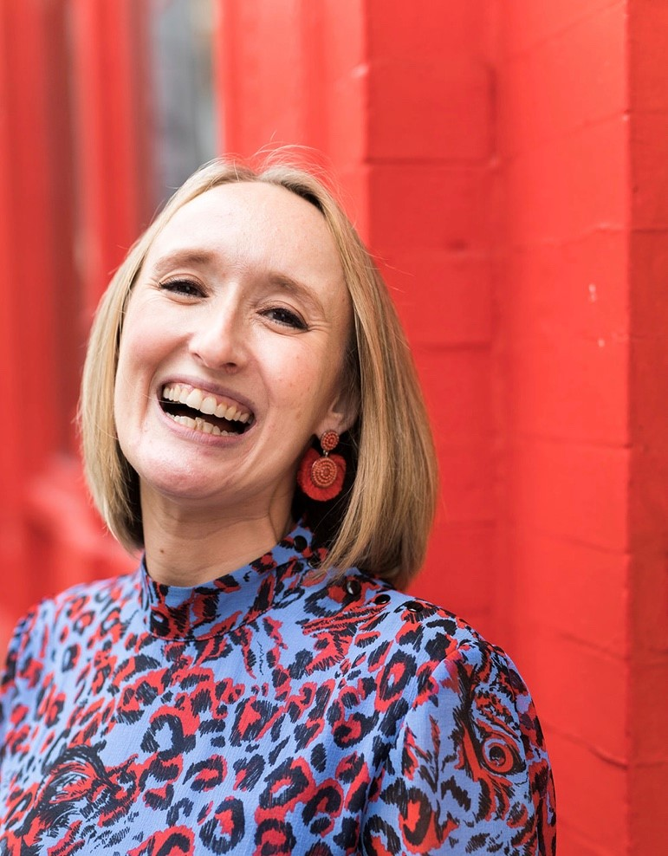
17 years industry experience
Welcome!
Consultant
Senior consultant
L and D consultant
Internal Recruitment Manager
Associate Director
Director of Operations
Training Consultancy owner
This group is all about and for you!
Notes:
Also worth mentioning I did BD for 5 years, 4 days a week, 6 hours a day. BD hasn’t changed too much – in terms of how we approach the phone, and what worked then, still works.

Slide 3
How do the webinars work?
1.5 hours of training content
Every month we will cover a different topic
We will have one comfort break of 5 minutes!
We will use the chat room, Miro boards and live discussion. There will be group work when appropriate and the numbers allow – so get involved!
We do need to see each others faces! Unless I explain otherwise e.g. if we have a lot of content to get through and we are running out of time
I will always ask you for questions
I will always ask for your full attention
You will always have mine
We will respect the confidentiality of our clients, candidates and colleagues

Slide 4
Objectives for this session:
Why do we get objections?
Changing our mindset
What might they look like?
What is the first thing we should do?
We need a plan
The formula…
Selling successfully
Asking for commitment in our close

Slide 5
By the end of this session you will be able to: know how to respond to common objections have a plan for the most common objection you are hearing right now increase your confidence to make progress in the call

Slide 6
Let’s talk about your mindset:
What do you expect to happen?
What is the reality?
Write down now what tends to happen..

Slide 7
Are we setting ourselves up for failure?
Reposition it
What are the REALISTIC expectations and outcomes?

Slide 8
Why do we get Objections?

Slide 9
Why do we get Objections?
They think its true
They want to get you off the phone
They are busy…
What they say could be true

Slide 10
What do people say when they have objections?
What might they sound like?

Slide 11
Current common objections:
We are not hiring…due to Covid
We are not allowed to use agencies… due to Covid
We have made redundancies… due to Covid
We have no budget….

Slide 12
We need to unpick and unpack what they tell us…

Slide 13
What do we do now??!
Don’t panic!
If we have changed our expectations and they are now realistic – i.e. we are going to get objections.
Don’t think of them as objections but a different route to your final destination
We can deal with them!

Slide 14
We need a plan…. And this is it!
This is your road map to success
Empathise
Question
Check
Sell
Confirm

Slide 15
What is the magic formula?
Follow the plan
Slow down
Listen! For understanding – NOT so you
can reply

Slide 16
Why do we ask questions?
To encourage thinking
To confirm and gain agreement
To probe for further clarification
To close on our objective(s)
To gain information & to establish facts
Notes:
Why do we need questions?
In recruitment there is no such thing as magic answers – But we do have magic questions. Questions have a strange quality – You cannot respond to a question without firstly thinking of an answer. Even with the answer ‘I don’t know’ you would still have to think through your knowledge and past experience to come up with that answer.
We have been programmed to ask closed questions over a period of time. This leads to limited conversation, and limited information gathering. As information gatherers by trade, we have to re-programme our brains into asking more effective questions in order to promote deeper thought, drill down into hidden needs/wants/issues and to influence our clients and candidates.
Clients (and some candidates) may be less receptive and open to talking to you – The right questions can mean the difference between that client or candidate talking to you ... Or not!
Lets take a look at the different types of questions... As we go through these, please make a note of which types of questions you and the other person were mostly using during the exercise...

Slide 17
We need a call plan
Open questions
Gaining information on –
The business
The department
The team
The line manager
The recruitment process
Notes:
Why do we need questions?
In recruitment there is no such thing as magic answers – But we do have magic questions. Questions have a strange quality – You cannot respond to a question without firstly thinking of an answer. Even with the answer ‘I don’t know’ you would still have to think through your knowledge and past experience to come up with that answer.
We have been programmed to ask closed questions over a period of time. This leads to limited conversation, and limited information gathering. As information gatherers by trade, we have to re-programme our brains into asking more effective questions in order to promote deeper thought, drill down into hidden needs/wants/issues and to influence our clients and candidates.
Clients (and some candidates) may be less receptive and open to talking to you – The right questions can mean the difference between that client or candidate talking to you ... Or not!
Lets take a look at the different types of questions... As we go through these, please make a note of which types of questions you and the other person were mostly using during the exercise...

Slide 18
95% of all sales people make the 1st sales call
50% of all sales people make the 2nd sales call
25% of all sales people make the 3rd sales call
15% of all sales people make the 4th sales call
10% of all sales people make the 5th sales call
Just 5% make that 6th call and they take 85% of the new business available in any market!

Slide 19
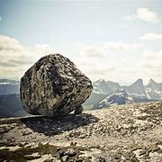
Setting multiple approach objectives – What to do if they say no
Have your information gathering questions prepared
Imagine what you want – i.e. live roles, is inside this rock.
You need to chip away at it
What questions will you
need to chip your way through to the centre?
You can ask about – them, their role, the business,
recruitment, agency usage, skills they need….
If they say no – where will you go next?

Slide 20
Always start with the end in mind
What shall I say to get into it?
What will they throw at me to stop me?
How will I respond?
How will I close?
What do I want out of it?

Slide 21
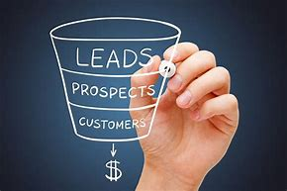
Plan your empathy statement and Questions for the most common Objection…
Notes:
This is on the members area

Slide 22
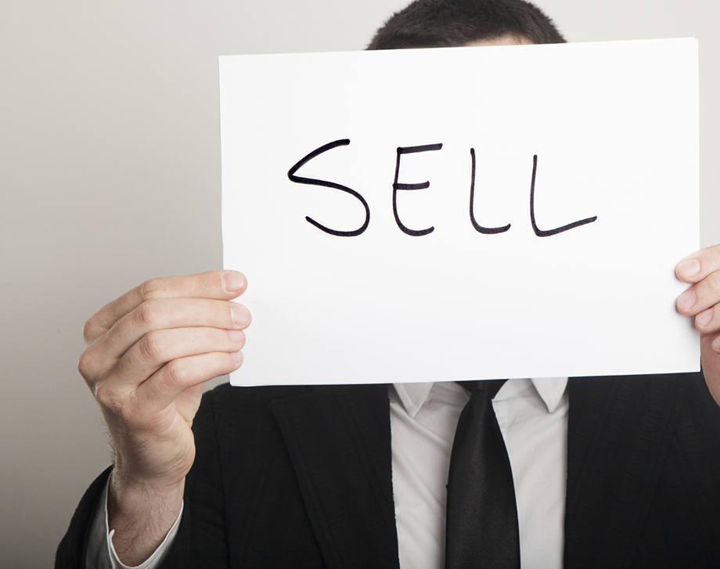
Can you now think about what solutions/ sells you can use with that particular objection?
Notes:
This is on the members area

Slide 23
How to close effectively and gain commitment
What could commitment from the client look like?
Remember your objectives for the call
What happens if we don’t close the call effectively?
WHY is closing the call well so important?

Slide 24
Based on what we have talked about today – is there any reason why you couldn’t come to me next time you are hiring?
No not at all – great! What in particular makes you feel confident to use me?
Would you feel comfortable in working together next time you are recruiting?
If they say yes – great – what have I said today that makes you feel comfortable enough…
Will you come to me next time?
Will you ring me first?
If they say – yes – Great! Why will you?
Notes:
This is on the members area

Slide 25
Use your personality!
Be memorable!
Keep going – keep your eye on the prize
Change your expectations to make progress

Slide 26
How does the RAC work?
How will Ali support me?
Week 1 – Webinar, interactive – share ideas and ask questions
Week 2 – Catch up with Ali on wins and challenges/ watch pre-recorded video/ other training material
Week 3 – Drop in clinic
Week 4 - Update Action plan, agree next steps

Slide 27
NO drop in this month – 1-2-1 conversations instead
If you would like a 20 minute call before we stop for the Christmas break, please reply to my email!
We will talk through your wins, what you can use from this masterclass going forward and start to think about your Q1 plan.
Your actions are to think about –
What will you try and use after this session?
What is your 1 commitment? Write it on your action plan
Module 4 Action plan will be added to the members area

