Slide 1
Module 11
The candidate journey

Slide 2
In this session we will be covering: Contact opportunities and nurturing your relationship Value added services - How you can attractively package these Candidate agreements – do you have one, and should you? Culture and actions – are these reflected in each other with your candidates? How to ask the difficult questions

Slide 3
Nurturing your relationships
Why is this important?
Think of a candidate you have a great relationships with
What does it look like?
How does it feel?
How to did you nurture it?
What were the steps you followed?

Slide 4
What service do your candidates want?
How do you know?
Have you asked them?
What is typical in our industry?
What will make you stand out?
What are you doing to stand out?

Slide 5
What does your candidate service look like?

Slide 6
How can we nurture the relationship
We want the relationship to flourish
How do we make sure this happens?
How many times do you talk to a candidate throughout a process?
Notes:
If enough attendees – put into break out rooms

Slide 7
Activity
In your room – share with your partner how many times on average you would speak to a candidate once they are in process
Start to map out how this will look to a candidate
Think about your business values and culture – what do you need to be doing at each stage to reflect this?

Slide 8
Value added services - How you can attractively package these?
List everything you do for your candidates?
Share some of them now…
In break out rooms – how can you package this when speaking to, and marketing to your candidates?
Get creative!
Share your ideas!
Notes:
Put into breakout rooms again – different groupings

Slide 9
Share your ideas…
What did you come up with?

Slide 10
Lets look at some examples:
Hays – candidate HUB

Slide 11
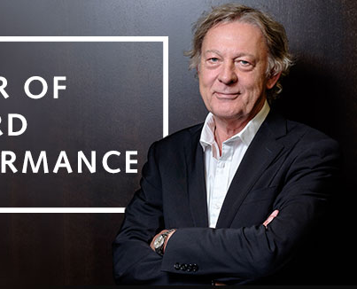
Robert walters
Working and job hunting remotely

Slide 12
Reed
Reed

Slide 13
Candidate agreements
What are they?
Do you have one?
Should you have one?

Slide 14
Culture and actions
Are these mirrored in your candidate journey?
How can you highlight your culture through the candidate journey
Talk us through now…

Slide 15
How to ask the difficult questions
What are the difficult questions we need to ask?
When should we ask?
How should we ask?

Slide 16
Glass door research:

