Slide 1


Module 10-How to take the perfect job spec

Slide 2

How do the webinars work?
1.5 hours of training content
Every month we will cover a different topic
We will use the chat room, Miro boards and live discussion. There will be group work when appropriate and the numbers allow – so get involved!
We do need to see each others faces! Unless I explain otherwise e.g. if we have a lot of content to get through and we are running out of time
I will always ask you for questions
I will always ask for your full attention
You will always have mine
We will respect the confidentiality of our clients, candidates and colleagues

Slide 3

Welcome!
Nearly 18 years in the Recruitment Industry
Consultant
Senior consultant
L and D consultant
Internal Recruitment Manager
Associate Director
Director of Operations
Training Consultancy business owner
Notes:
Also worth mentioning I did BD for 5 years, 4 days a week, 6 hours a day. BD hasn’t changed too much – in terms of how we approach the phone, and what worked then, still works.

Slide 4

Objectives for this session:
Know what the common mistakes are when taking a job specification
Know the difference between a brief and a specification
Know you can influence your clients to get the information you need
Know what language will enable you to get that information
Increase your fill rates by receiving timely feedback and decision making

Slide 5
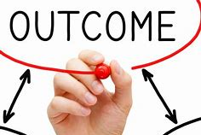
By the end of this session you will be able to:
Influence your clients through and throughout your BD calls
Be mindful of your language and questions to get clients buy in and agreement
Post course work - Create a template Job specification with questions in your style for Ali to appraise

Slide 6

But first!
What are the common mistakes?
Not taking enough time to ask the right questions!
Not asking the right questions
No setting objectives for the call
Allowing your self to be rushed off with no call back arranged
Not consulting
Saying yes to everything
Not selling the benefits of why you need the information
Not setting up this part of the process in your BD calls

Slide 7

How can we set this up at the beginning of the call?
And perhaps before this stage?
Not taking enough time to ask the right questions!
Notes:
We need to manage the clients expectations here
How long on average does it take to take down a really comprehensive job spec?

Slide 8

Not asking the right questions

Slide 9

No setting objectives for the call
What are your objectives for this call?
Why does it need to be over the phone and NOT email?
sub text sub text sub text sub text sub text sub text
sub text sub text sub text sub text sub text sub text
Notes:
What are your objectives if the client doesn’t have much time?
What are the 5 key things you need? Look at the spec..

Slide 10


Allowing your self to be rushed off with no call back arranged
How can we maintain control here?
Slow down
Arrange a call back
Tell them when and for how long
Is that going to work for you?

Slide 11

Not consulting/Saying yes to everything!

Slide 12




Not selling the benefits of why you need the information
Let’s discuss some examples.
Have a look at the job spec – which questions do you find difficult to get the information for?

Slide 13

Not setting up this part of the process in your BD calls

Slide 14

Look at the job spec I sent you…
How would you change this to work for you?
Notes:
Breakout rooms x2

Slide 15
What is the difference between a job specification and a Job brief?

Slide 16

How can we influence our clients?
Pains
Benefits selling
Be consultative
The science of persuasion

Slide 17


Slide 18





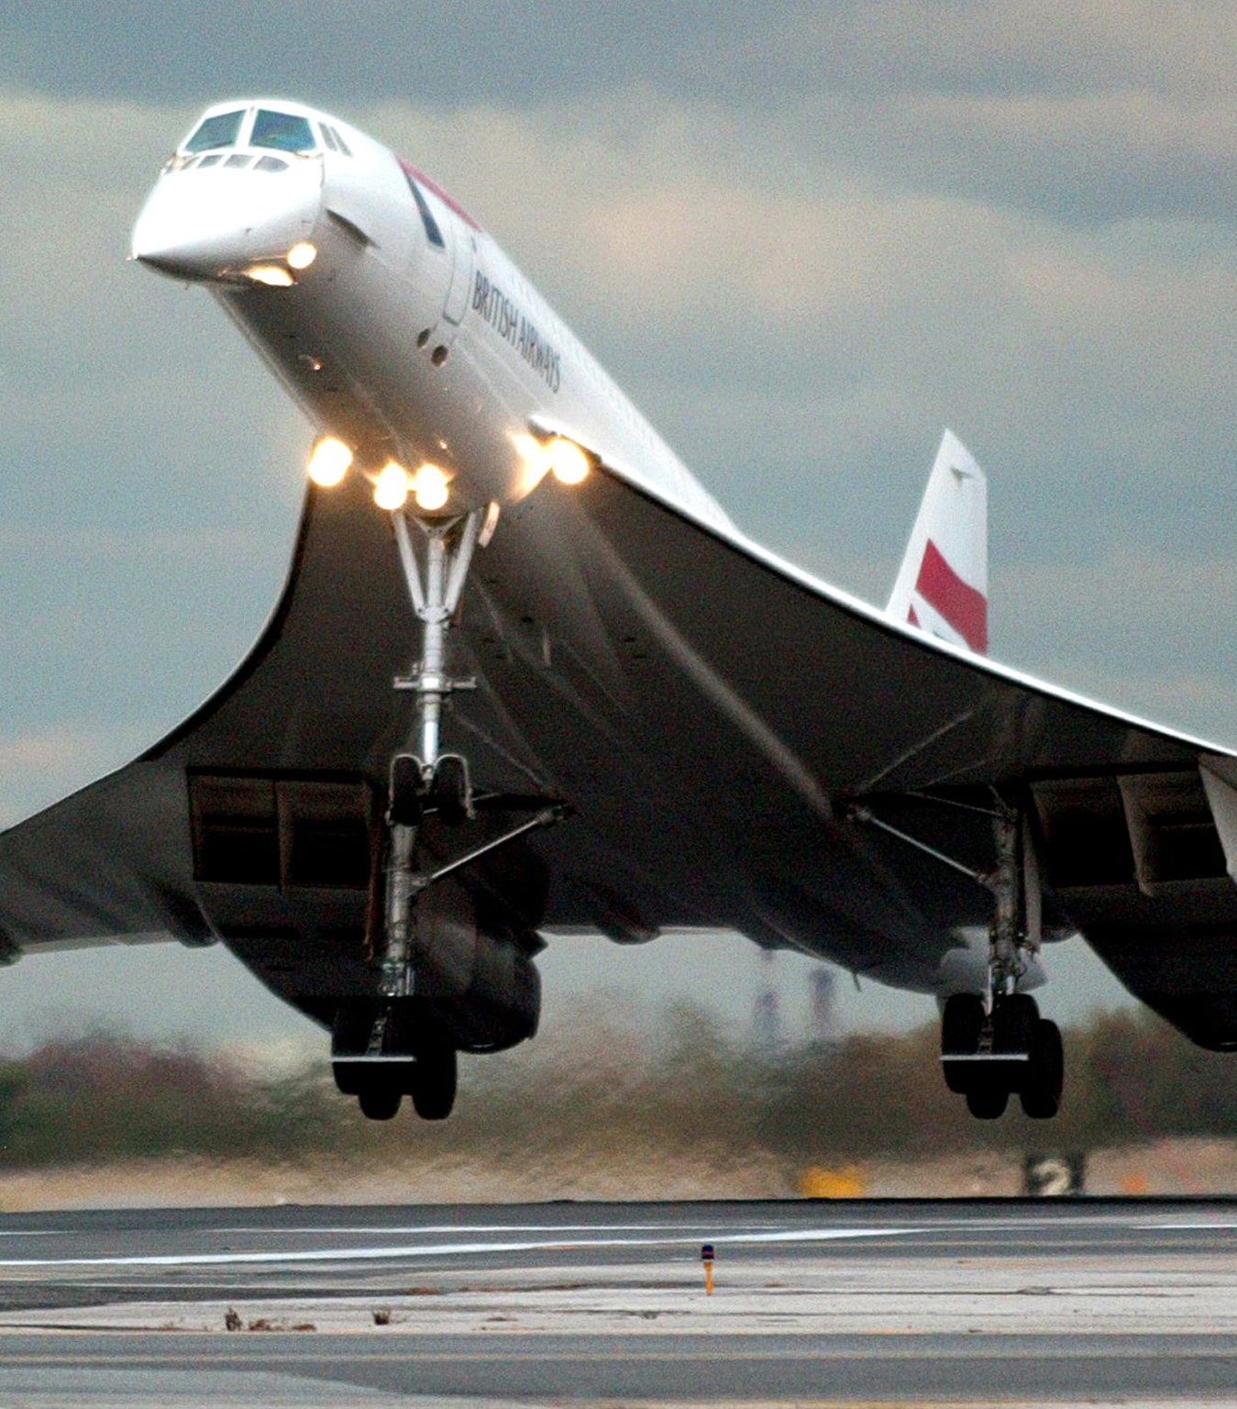
Module 9 – the 6 powers of persuasion –
We are building on our power of influence:
Reciprocity
Scarcity
Authority
Consistency
Liking
Consensus

Slide 19

How to win friends and influence people

Slide 20
How to Win Friends and Influence People: The Principles
Principle 1: Become genuinely interested in other people
Principle 2: Smile
Principle 3: Remember that a person’s name is to that person the sweetest and most important sound in any language
Principle 4: Be a good listener
Principle 5: Talk in terms of the other person’s interests
Principle 6: Make the other person feel important—and do it sincerely

Slide 21

Notes:
Will share the link to his TED talk
Successful leaders share 4 traits
Context
Breadth
Choice
connection
Context – be deeply curious

Slide 22

Why is the language we use at this stage so important?
How would you describe the type of language we need to use/
What affect do we want to have?
Control
Professional
Look at the job spec again….
Post work – have a look at the questioning techniques from mindtools – what could you use in the Job spec stage? Why?
Notes:
Commands
Examples

Slide 23

Interview and Feedback process:
Notes:
What goes wrong here?
How can we ensure this doesn’t happen?
Look at your job spec – what can we use to control the process here?

Slide 24

How to take the perfect job spec?
Be clear on your objectives
Be prepared
Be aware of your language
Be slow…
Be curious
Be in CONTROL - Prepare the client throughout your calls and before hand

Slide 25

What do you need help with right now?
Notes:
e.G I don’t have time
You know what I want
The usual
I don’t have time

Slide 26


Drop in will be on Tuesday 23rd June at 12 p.m. UK time
Don’t forget to book in your 1 to 1 coaching with me!
Members get 30 mins a month!
Or you can get a coaching hour for £128+ VAT
We will talk through your wins, what you can use from this masterclass going forward and discuss your Q3 goals.
Your actions are to think about –
What will you try and use after this session?
What is your 1 commitment? Write it on your action plan
Module 10 Action plan will be added to the members area

