Slide 1
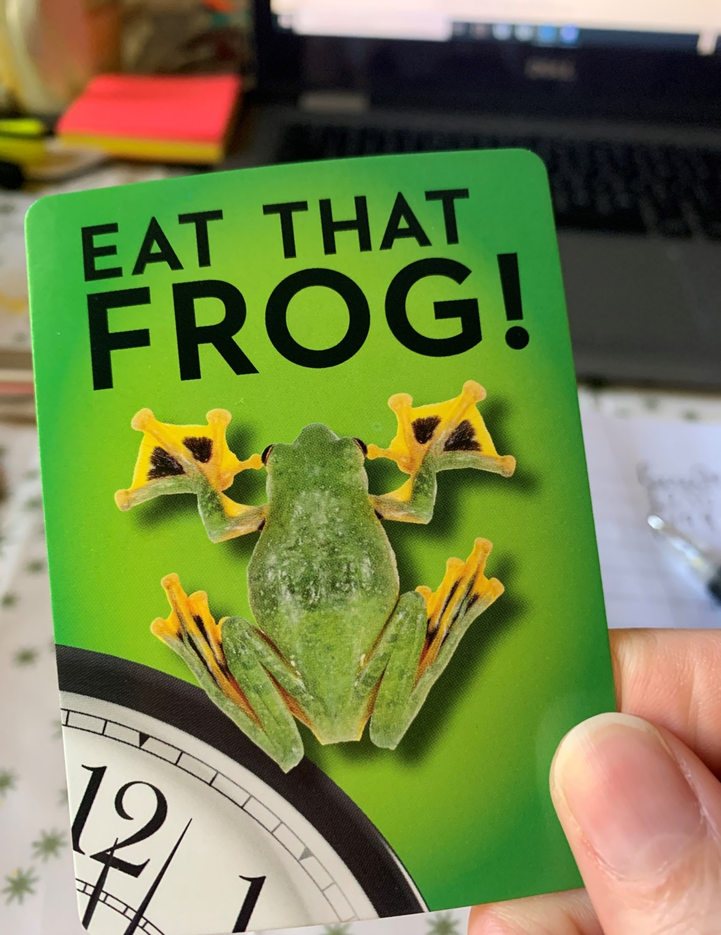
Eat that Frog!
How to get S**t done!
An RAC Masterclass
Based on Brian Tracy’s international bestseller

Slide 2
What will we be covering?
New habit formation
3 D’s
Think on paper in 7 steps
Plan every day in advance
80/20 Rule
Long term thinking
Law of forced efficiency
Plan your time carefully – not deadlines

Slide 3
What will we be covering?
Detaching from technology
Focus your attention
Slice and dice
Create large chunks of time
Develop a sense of urgency
Complete every task!

Slide 4
By the end of this session you will be able to:
Stop procrastinating and get S*&^t done!
Have some practical tips to take away and try – do feed back to the group on what works for you and what doesn’t!
I will set up a new Whatsapp group to share wins and learns if people are interested

Slide 5
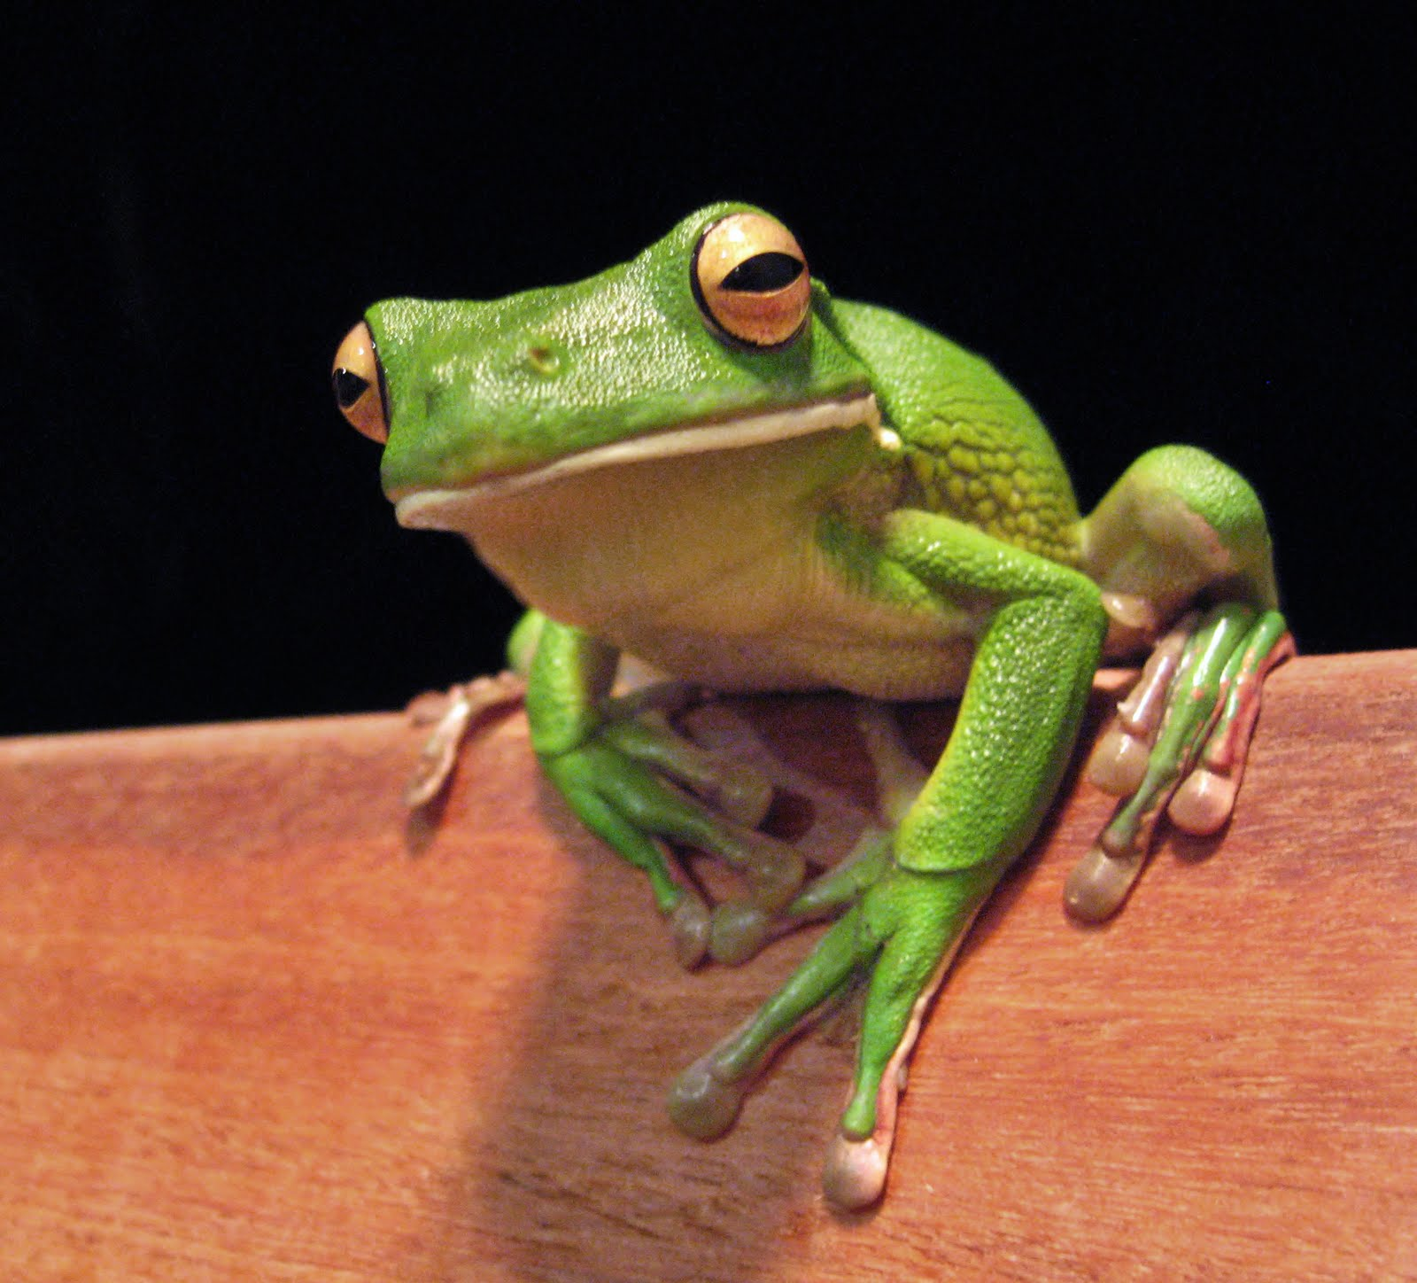
New habit formation
“The habit of setting priorities, overcoming procrastination and getting on with your most important tasks is a mental and physical skill. “
Notes:
Need to practice – repetition – then becomes a habit and easier to do

Slide 6
The 3 D’s
Decision
Discipline
Determination
Notes:
Make a decision to develop the habit of task completion
Discipline yourself to practice until it’s a habit
Determination until the habit is formed and is a part of you

Slide 7
Think on paper in 7 steps
Decide exactly what you want
And order in priority
2) Write it down – only 3% of adults have written goals – and achieve 3-5 x as much as people with equal or better education. What does this tell us ? It doesn’t matter where you’ve come from – but it does matter where you are going!
3)Set a deadline and sub deadlines on your goal
Notes:
Decide esxactl what you want
And order in priority
2) Write it down – on;y 3% of adults have written goals – and achieve 3-5 x as much as people with equal or better education. What does this tell us ? It doesn’t matter where you’ve come from – but it does matter where you are going!
3)Set a deadline and sub deadlines on your goal
4) Make a list of everything you will need to do in order to achieve your goal
It gives you a track to run on
5) Organise the list into a plan – you can create a flow diargram for this – visual learner?
6) Do something on your plan – anything, just get started!
Execution is everything – a brilliant plan wth no action or an average plan with action – you decide
7) Do something everyday towards your goal

Slide 8
Think on paper in 7 steps cont.d
4) Make a list of everything you will need to do in order to achieve your goal it gives you a track to run on
5) Organise the list into a plan – you can create a flow diargram for this – visual learner?
6) Do something on your plan – anything, just get started!
Execution is everything – a brilliant plan wth no action or an average plan with action – you decide
7) Do something everyday towards your goal
Notes:
Decide esxactl what you want
And order in priority
2) Write it down – on;y 3% of adults have written goals – and achieve 3-5 x as much as people with equal or better education. What does this tell us ? It doesn’t matter where you’ve come from – but it does matter where you are going!
3)Set a deadline and sub deadlines on your goal
4) Make a list of everything you will need to do in order to achieve your goal
It gives you a track to run on
5) Organise the list into a plan – you can create a flow diargram for this – visual learner?
6) Do something on your plan – anything, just get started!
Execution is everything – a brilliant plan wth no action or an average plan with action – you decide
7) Do something everyday towards your goal

Slide 9
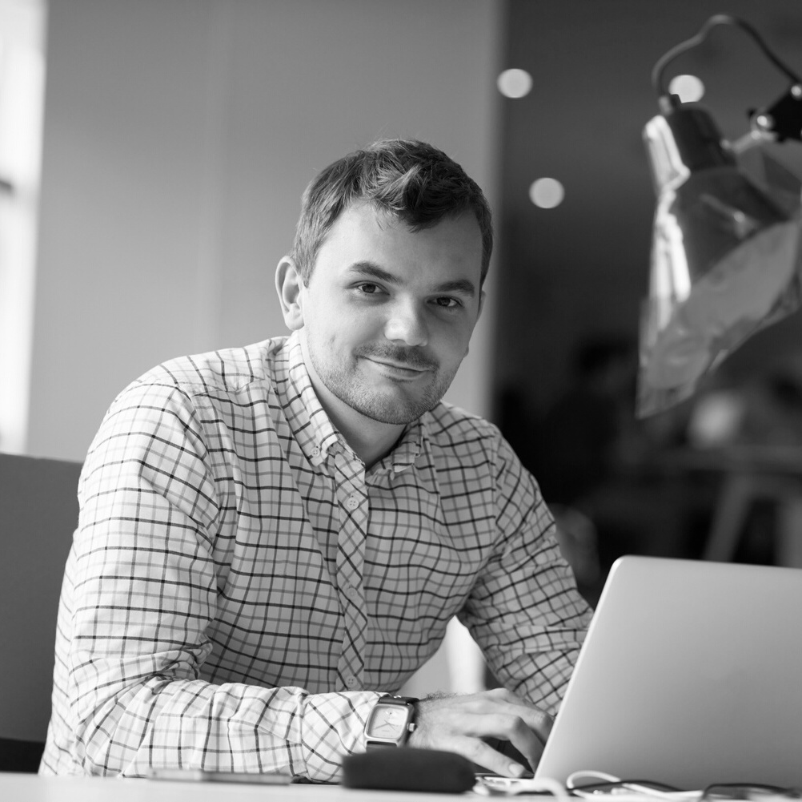
Plan every day in advance
Text text text text text
Every minute spent planning saves as many as ten minutes in the carrying out of that action
Notes:
You can increase your productivity and output by 25% or more, about 2 hours + a day when you work from a list

Slide 10
Plan every day in advance
Text text text text text
Every minute spent planning saves as many as ten minutes in the carrying out of that action
Notes:
Monthly list/ weekly/ daily
We are looking for visible progress!

Slide 11
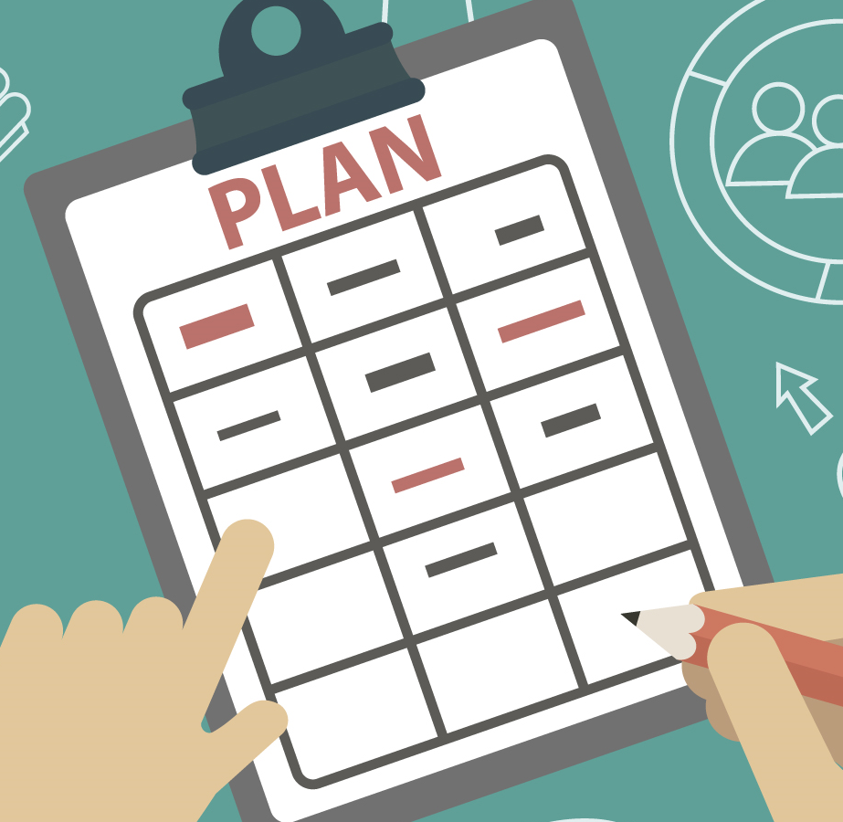
Use the 10/90 rule
Notes:
10/90 rule
The first 10% of time you spend planning and organising your work before you start will save you as much as 90% of the time getting the job done once you’ve started…
Has this happened for you?

Slide 12
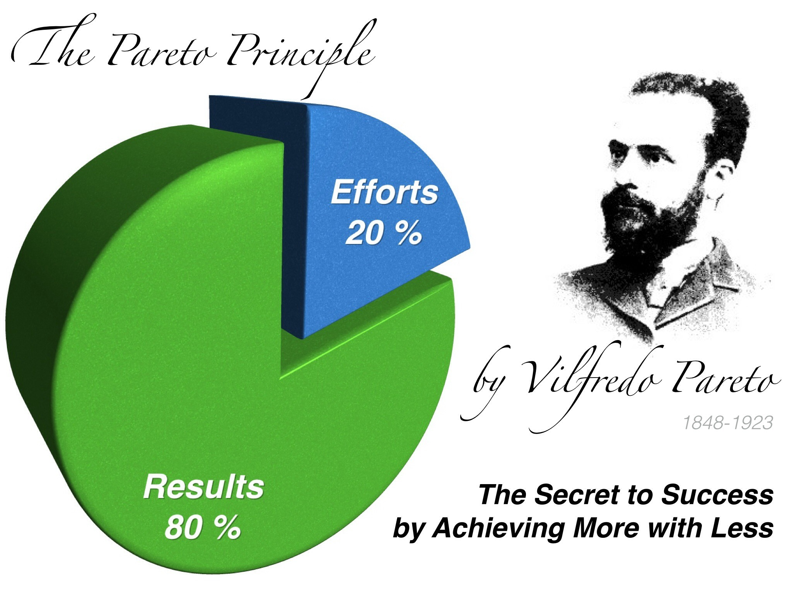
80/20 Rule
Notes:
The Pareto principle
80% of results are from 20% of the work
Out of a list of ten - two will have more worth than the other 8 altogether
The most valuable tasks are the hardest and most complex
It feels difficult- because it is! Which is why we put them off – we intuitively know what we should be doing…
Resist the urge to do the small things first!

Slide 13
Long term thinking
“Future intent influences and often determines present actions”
Notes:
We should be doing this as recruiters anyway
Knowing what is important in the long term helps you make better decisions for the short term

Slide 14
The Law of Forced Efficiency
“There isn’t enough time to do everything, but there is always enough time to do the most important thing.”
Notes:
Get your list out!
What did you have in list 1 – jobs you put off
List 2 – tasks your happy to start

Slide 15
3 questions for max productivity
What are my highest value activites?
What can I and only I do, that will make a real difference?
What is the most valuable use of my time?
Notes:
Three questions for maximum productivity
Answer these now and share

Slide 16
Plan your time carefully
Notes:
Plan your time carefully – not deadlines

Slide 17
Detach from technology
Notes:
You have a choice
Don’t become addicted – easier said than done
Take back you time
Refuse to be a slave
Someone will tell you

Slide 18
Poor performance produces procrastination
Notes:
Do you avoid jobs and tasks that you find hard BECAUSE you need to improve in this area?
I know I do!!
Identify what you need to improve on and create a plan that tackles it and means you will get better.
Is anyone willing to share theirs?

Slide 19
Focus your attention

