Slide 1
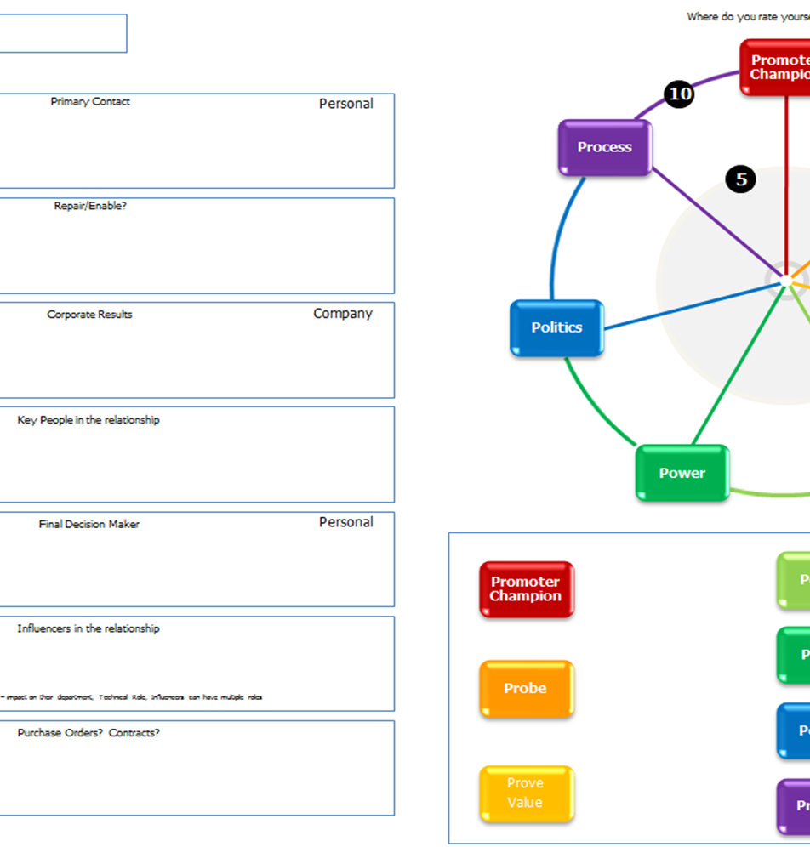
The 7P wheel of Account Management
Notes:
Trainer notes:
The 7P wheel is a simple tool that delegates can use to map out each individual client and where they need to delve deeper to identify the potential within the account.
Its essentially a planning tool and one can be completed for each client
The circle on the right is a visual representation of the account. You can out a cross on the line for each P based on where you currently are on a scale of 1-10
The boxes on the left is where you write the action you’re going to take to increase the score on each “P”
The box on the bottom right is just to write the actual number you gave each “P”

Slide 2
Promoter
The Promoter is the person who is your main point of contact
How good is your relationship with them?
Could it be better?

Slide 3
Probe
Have you questioned the client sufficiently to know what their future recruitment plans are?
Do you know what their “pain” is? Their pain is the reason why they need to work with you and not do the recruitment themselves

Slide 4
Prove value
How does the client measure success in their company?
Is it just revenue or are there other measures?
How can you help the client in a way that directly links to how they measure success?

Slide 5
People
Do you know who all the key people are in the business?
Do you only have the one contact? What would happen if they left?
Who else might you need to make contact with?

Slide 6
Power
Who has the main power within the account?
Who is/are the decision makers?

Slide 7
Politics
Are they dealing with any other recruiters?
If so, do you know how much of the clients business the other recruiters have?

Slide 8
Process
What is their recruitment process?
From when a client says “yes, go ahead and recruit for me” to you getting paid by the client, how long does that usually take?

